Slide 1

CareerPaths
A Career Services Application

Slide 2
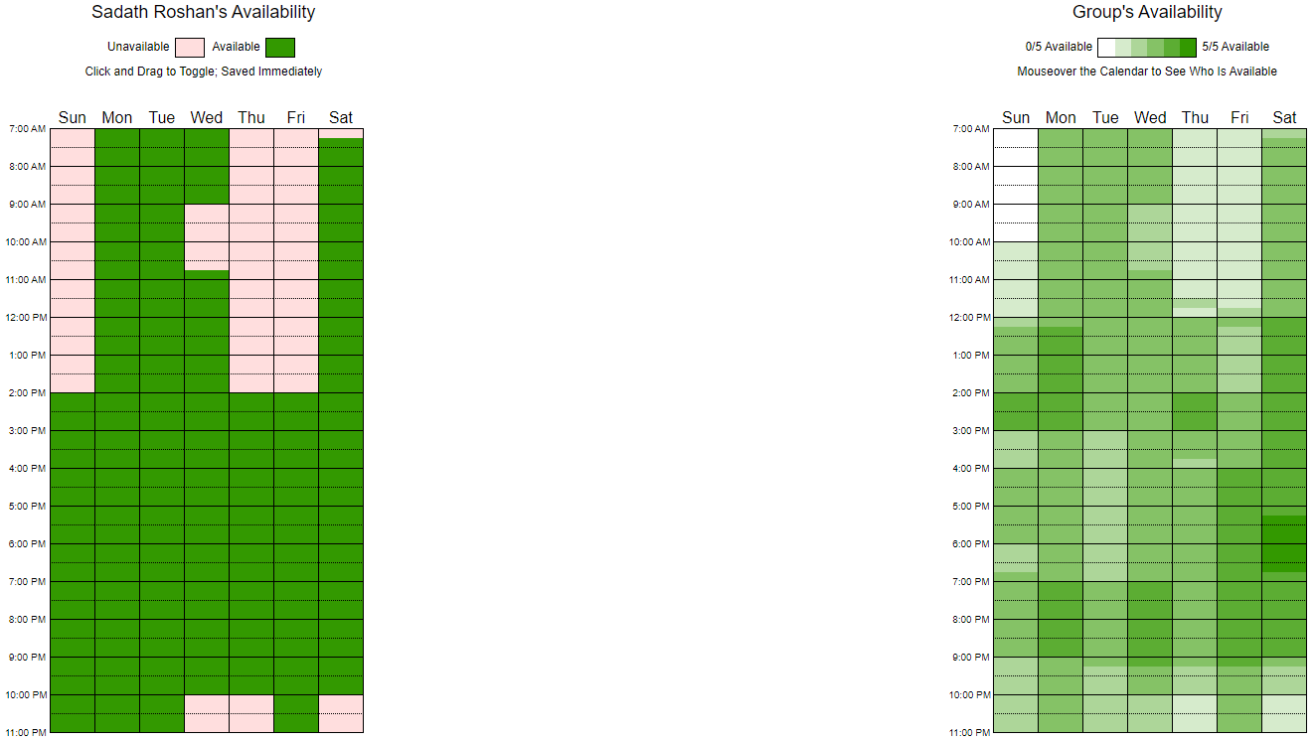
PRODUCT DESCRIPTION AND TEAM
TEAM ROLES
TEAM AVAILABILITY
The aim of this project is to establish a Career Services Platform that enables Employers to post new Job Opportunities and Candidates (seeking employment) to create and update their portfolios, enabling them to apply for the positions
SADATH ROSHAN | SCRUM MASTER
PANKAJ DEEP SAHOTA | BACKEND-DEVELOPER
LAKSHYA KALIA | FRONTEND-DEVELOPER
SINDOORA RAO | FRONTEND-DEVELOPER
MANISH GAUTAM | BACKEND-DEVELOPER
MANASA YALAKALA | BUSINESS ANALYST / Q.A.

Slide 3
CONTENTS
01
PRODUCT PLANNING
04
IMPLEMENTATION
PROJECT APPROACH, TECHNOLOGY STACK, EPICS, USER STORIES
FRONTEND DEVELOPMENT, BACKEND DEVELOPMENT, INTEGRATION
02
SPRINT PLANNING
05
USER STORIES, STORY POINTS, TASK BREAKDOWN, TASK POINTS & ASSIGN
VERIFICATION & VALIDATION
WORKING APPLICATION
03
PROJECT ARTEFACTS
06
CONCLUSION
MoMs, GITHUB WIKI, SPRINT BACKLOG, TEST CASE DOCUMENTS
DEMO, PROJECT OUTCOMES

Slide 4
PRODUCT PLANNING
APPROACH
TECH STACK
EPICS
01
TOOLS - Microsoft Teams, GitHub, Visual Studio Code, Postman, METHODOLOGY - Agile Methodology, Model-View-Controller
FRONTEND - HTML + Angular + CSS
BACKEND - Node JS Express + Sequelize
DATABASE - MySQL
TESTING - Jest
02
Employer Management and Job Posting
Candidate Profile Management and Job Application
Tracking Job Postings and Applications
Administrative Management of User Accounts, Job Postings and Applications
03

Slide 5
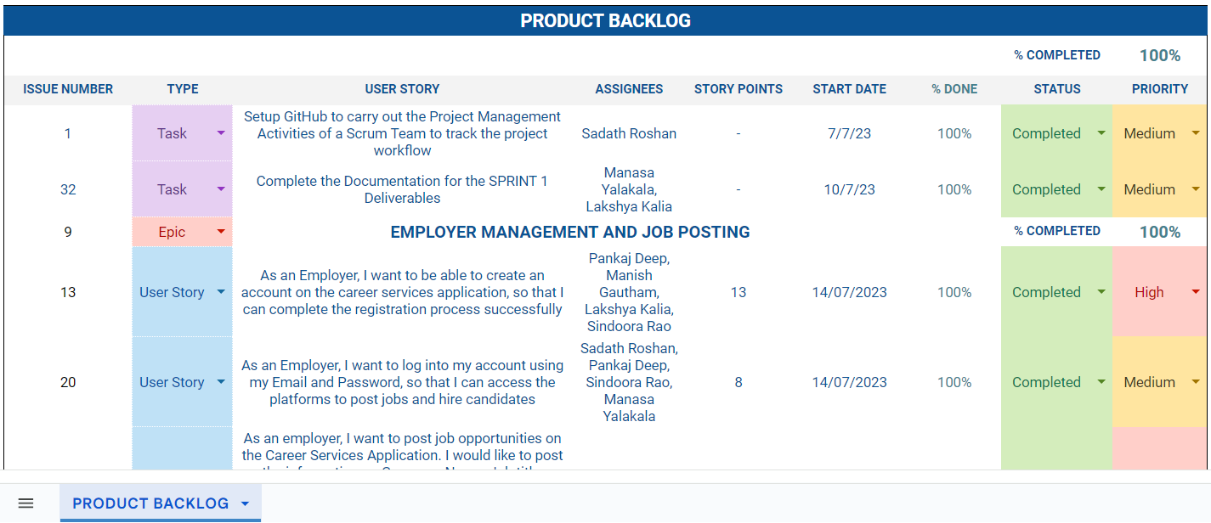
PRODUCT BACKLOG
04

Slide 6
SPRINT PLANNING
USER STORIES
STORY POINTS
TASK BREAKDOWN
ASSIGNMENT
Developed User Stories corresponding to each of the Epics.
Assigned User Stories to team members based on role and expertise.
Conducted in-person Sprint Planning Meetings and assigned Story Points using Planning Poker.
Identified tasks required to realize a particular User Story.
Estimated task points as number of hours required to complete a task.
Divided team members into sub-teams of 2, and assigned individual tasks to be carried out using Pair Programming.

Slide 7
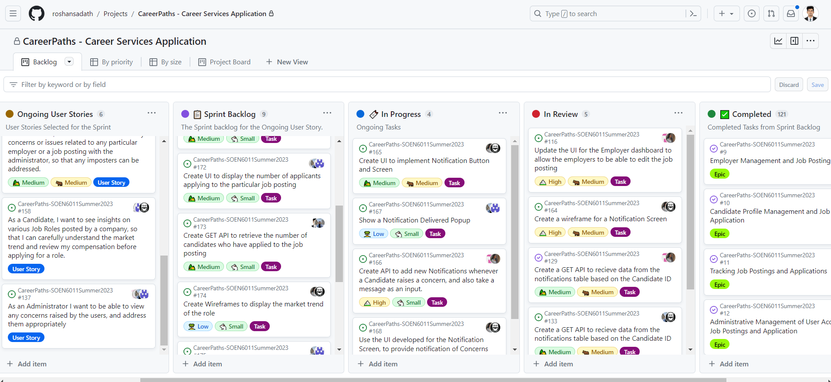
PROJECT MANAGEMENT

Slide 8
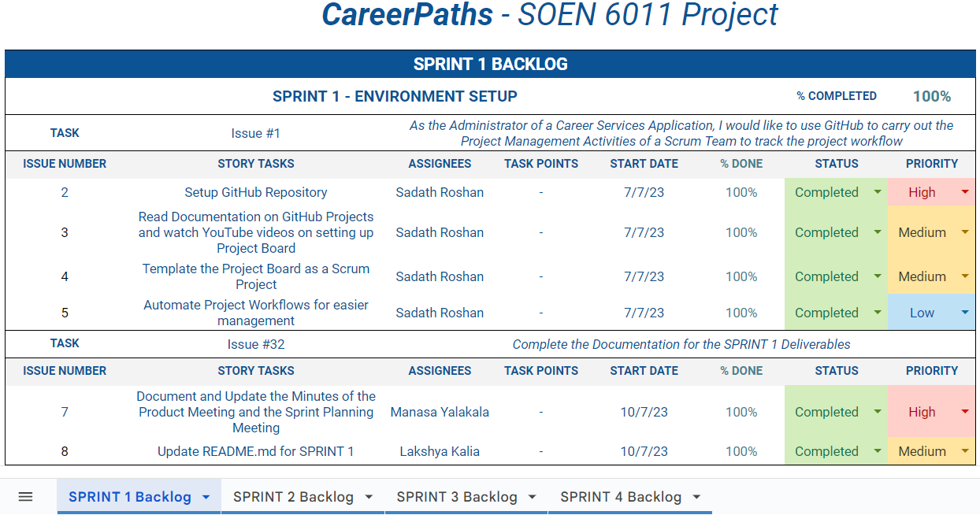
PROJECT ARTEFACTS
MEETING MINUTES
SPRINT BACKLOG
Recorded Minutes of the Meeting for Sprint Planning and Bi-weekly Scrum
Minutes included, Agenda, Sprint progress, Discussion and Action Items

Slide 9
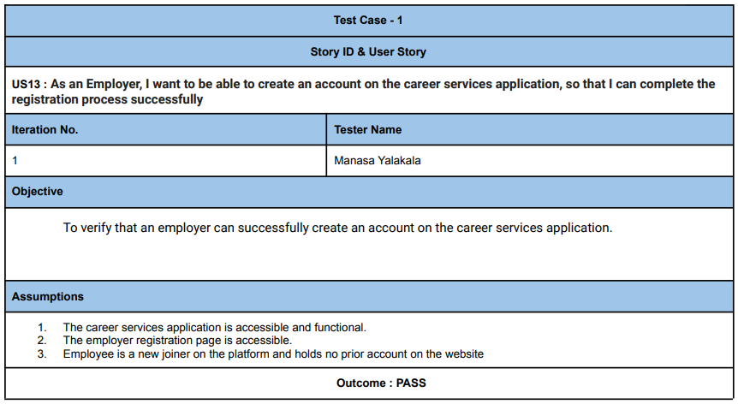
GITHUB WIKI
TEST CASE DOCUMENT
Recorded all the Project Artefacts from SPRINT 1 - SPRINT 4 in the GitHub Wiki for reference of all related activities and documentation including Product and Sprint Backlogs, Minutes of Meetings, and Acceptance Test Cases
Wrote Acceptance Test Cases for each of the User Stories in any given Sprint

Slide 10
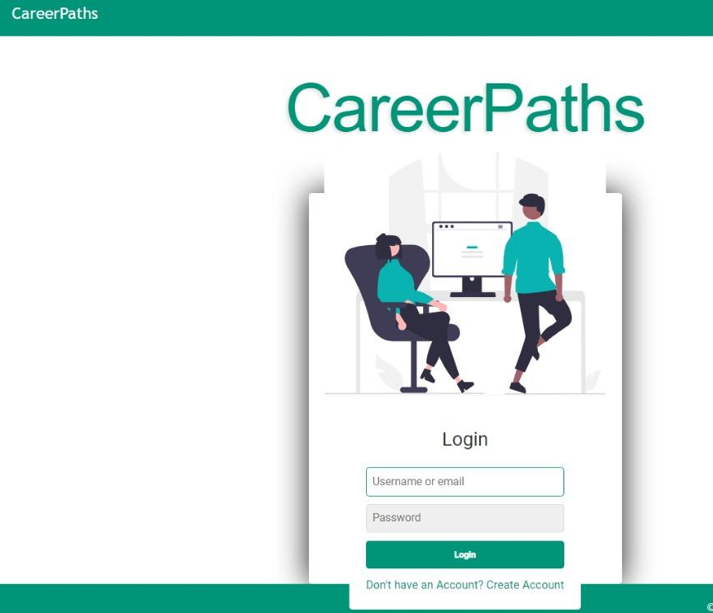
IMPLEMENTATION
Identified User Stories for Epics in respective Sprints, and carried out assigned work by designing Frontend using Angular, HTML and CSS, and designed the Backend using the Model-View-Controller Architecture in Node JS Express using Sequelize as Object Relational Mapper for the MySQL Database, designed for the application.

Slide 11
Our project's architecture seamlessly integrates Angular on the frontend and Node.js with Express on the backend. Angular empowers users with an intuitive interface, while Node.js processes their requests via Express APIs.
Authentication relies on JWT, ensuring secure user login and safeguarding data transmission. Sequelize models define database structures, and controllers manage logic, with routes shaping API endpoints.
The frontend triggers requests, the backend handles them, retrieves or alters data through controllers, and communicates responses back. This modular approach enhances maintainability and scalability, fostering effortless integration. This collaborative design embraces secure authentication and lays the foundation for future expansion while maintaining a user-centric experience.
We have further implemented TWO additional features into the application including the NOTIFICATIONS Feature and the APPLICATION INSIGHTS into the Job Posting and leaving room for including novel features to make the application future-proof.

Slide 12
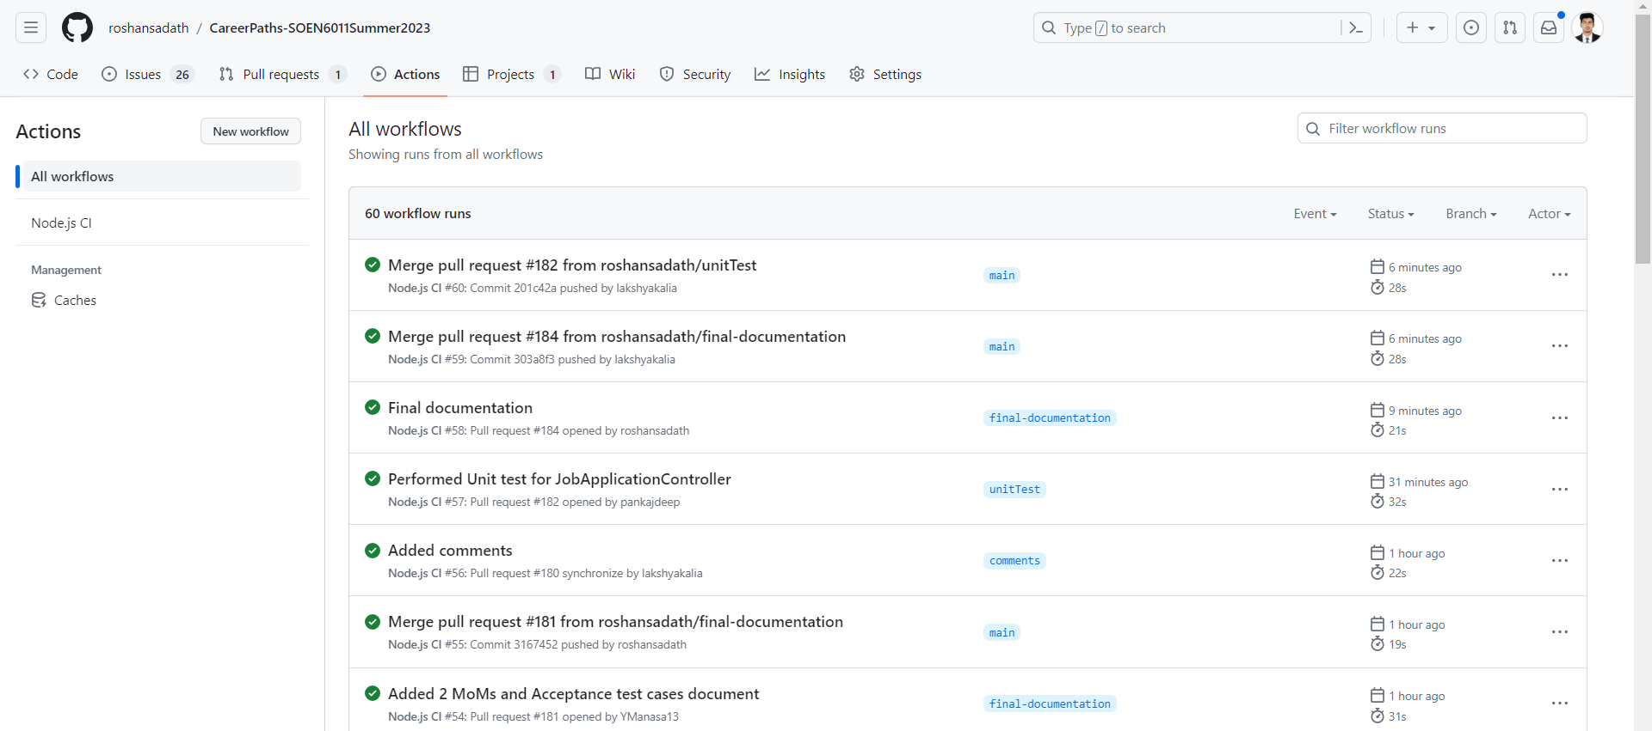
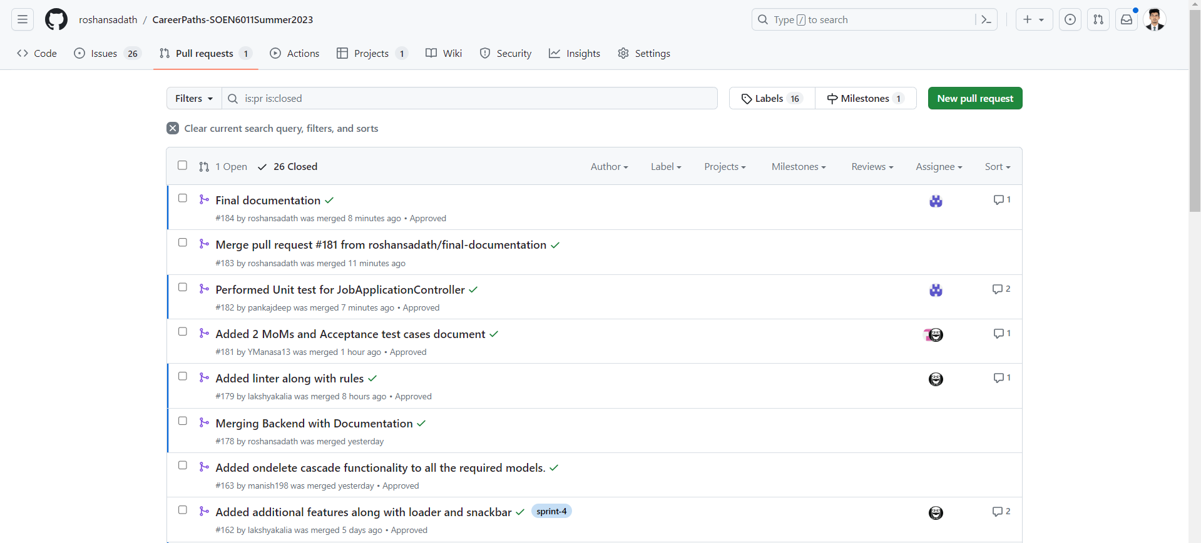
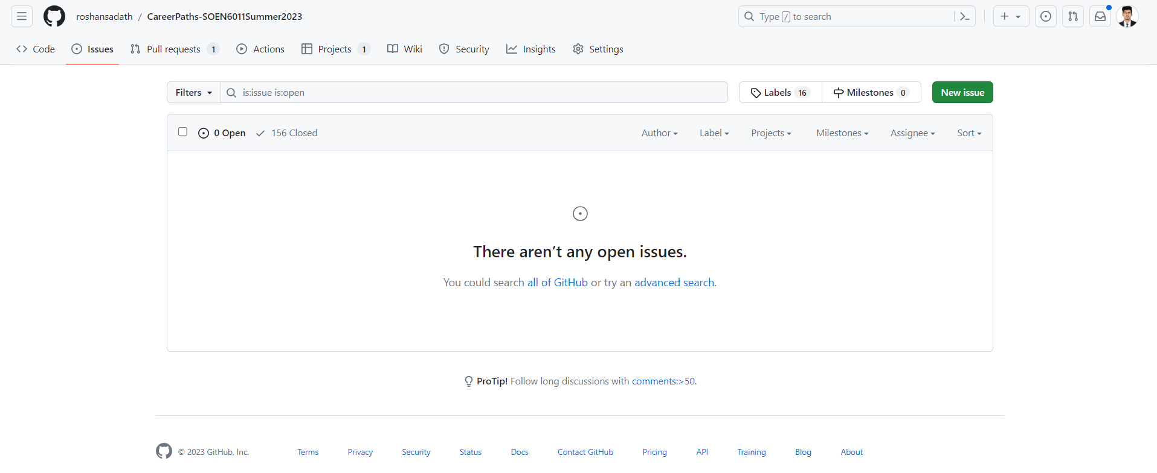

Slide 13
VERIFICATION & VALIDATION
Acceptance testing for all the user stories and the workflows involved has been tested manually and documented by our QA.
ACCEPTANCE TESTING
We have scripted a YAML file into our git workflows. For every commit the script is executed. It will perform clean installation of node dependencies, cache/restore them, build the source code and run tests across different versions of node. This CI run is monitored on a daily basis and issue is addressed on priority.
INTEGRATION TESTING
We have left no stone unturned in our commitment to quality, subjecting all our Node.js components to rigorous unit testing facilitated by jest framework.
UNIT TESTING

Slide 14
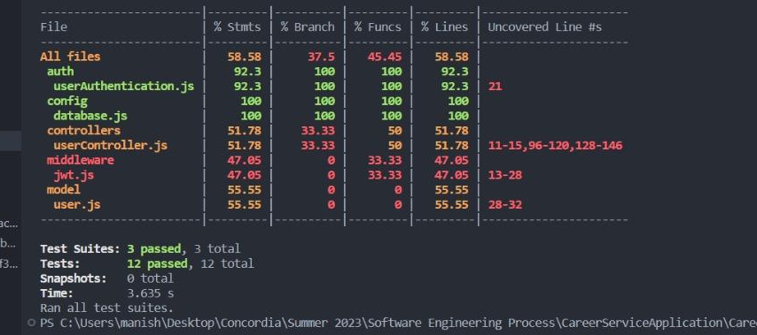
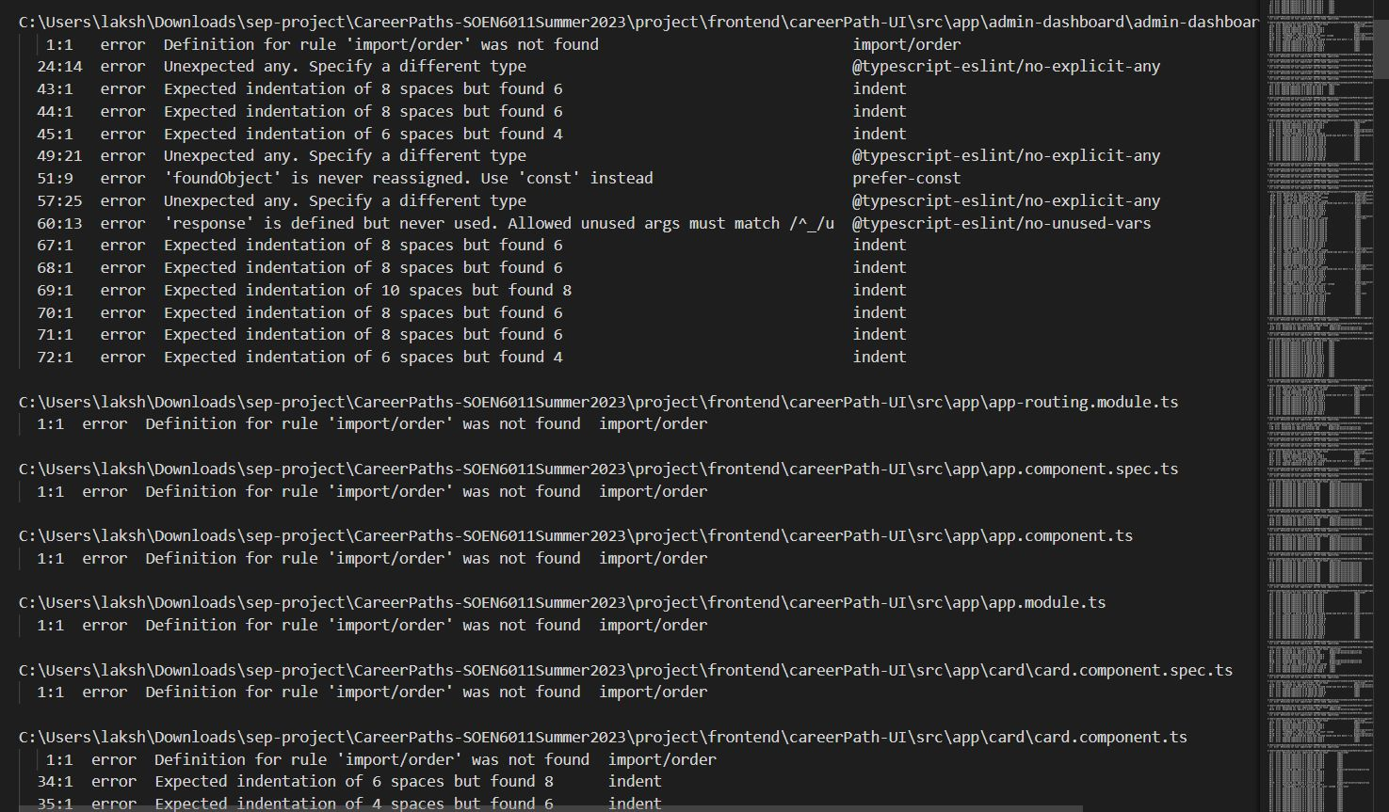
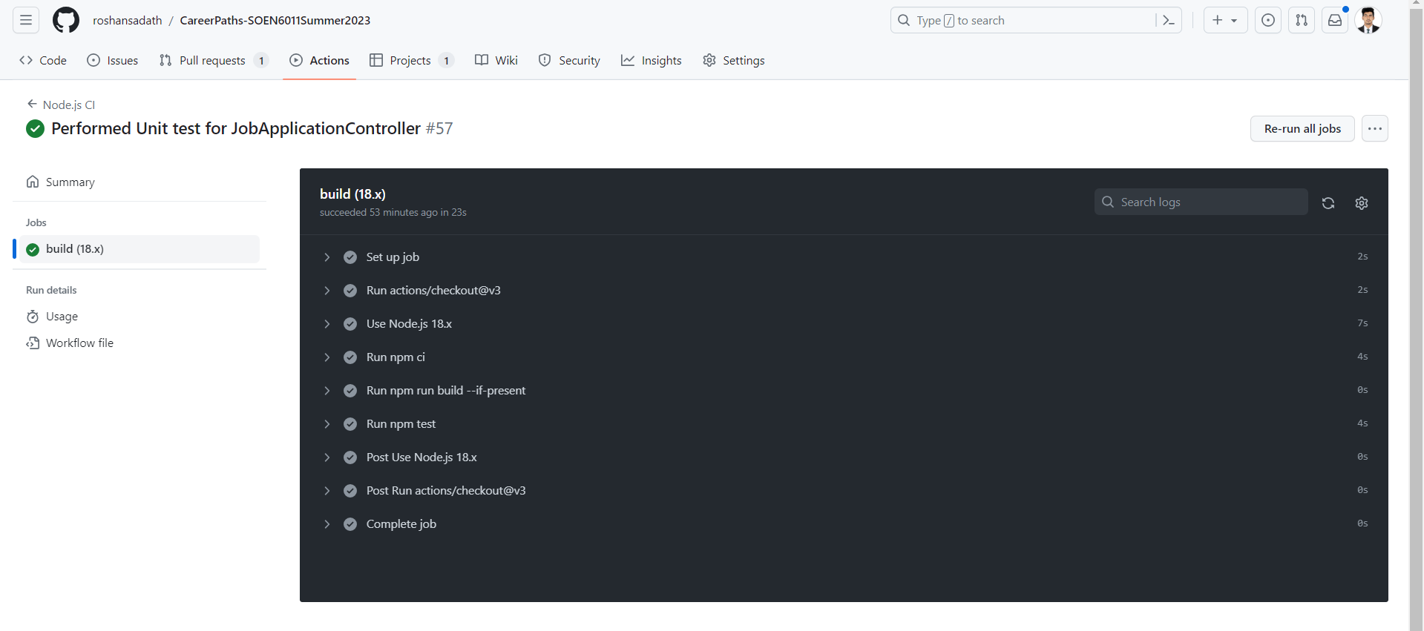
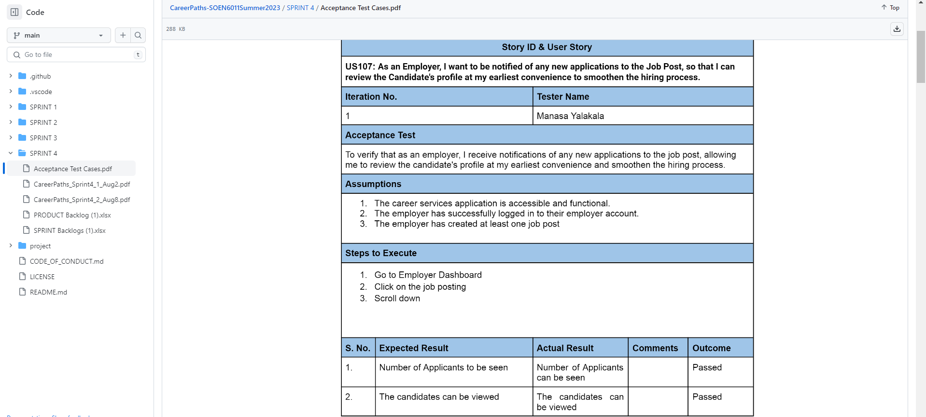

Slide 15
CONCLUSION
PROJECT OUTCOMES
CONTINUOUS INTEGRATION
IMMENSE TESTING
The Team has successfully collaborated to develop the Career Services Application realizing all the Requirements of the project while also implementing 2 additional features into the applications. Whilst ensuring that the software being developed anticipating future changes and improvements.
For each of the Sprints the team has duly Validated the product developed a the end of the sprint, with the requirement specification of each of the Epics, carrying out through Acceptance Testing, before moving onto the next Sprint. While also ensuring robust and efficient releases of the Application.
The application has undergone multiple levels of testing both White-box and Black-box in order to properly validate and verify the system, based on the requirements. The team has performed User Testing, Integration Testing and Unit Testing, and also run Linters on the code in order to remove any inconsistencies and make the application more maintainable.

